Slide 1
Data Structures and Algorithms IICT-6005
Linked Lists

Slide 2
Lesson Content
Issues with Arrays and Array Based Vectors
Linked Lists as an alternative
The Node class
Singly Linked List
Operations on Singly Linked Lists
Application of Singly Linked List:
Stack
Queue

Slide 3
Issues with Arrays and Array Based Vectors
Although the Array Based Vector is an efficient implementation of the Vector ADT for retrieving and updating an element at a given rank, Array Based Vectors do have some disadvantages:
They are based on arrays, and therefore, for an Array Based Vector of size n, a contiguous memory allocation of size n is required.
Adding an item or removing an item, to or from the start of the Array Based Vector results in an inefficient operations where a number of elements have to be moved.

Slide 4
Linked Lists as an Alternative
Array Based Vectors are not the only available implementation of the Vector ADT, in fact, there are many other available alternatives.
One simple alternative is the use of a Linked List.
The linked list, acts like a chain of nodes, where each node contains an element and a link to other chains.
Note:
To properly understand the way that Linked Lists work, it is important to revise properly the reference and value-type variables and how they work.
Linked Lists make heavy use of pointers to link nodes together, hence we must be careful with reference types!

Slide 5
Linked Lists as an Alternative
Head of list Head : Node
The size of the list Size : Integer
The element is the object being stored within the node.
B
5
A
Next : Node
In a Singly Linked List, each node has an element and a link to the next node.

Slide 6
Singly Linked Lists
The Singly Linked List is an implementation of the Vector ADT based on a sequence of objects(nodes) linked together by a pointer.
The Singly Linked List starts from the Head of the list, and follows the nodes until the Next Pointer of the Last Node points to Null.
In an Empty Singly Linked List, the Size is 0 and the Head of the list points to Null.

Slide 7
The Node class
Element: object
Next: Node
A

Slide 8
The Node class
The Linked List is made up of a chain of Nodes.
The Node in a Singly Linked List has a pointer to the Next Node.
If the current Node is the last Node, then Next points to Null.
The Element is used to store the elements in the Singly Linked List.
A

Slide 9
The Node class
The first Node in a Singly Linked List is called the Head of the list.
Here, the first Node of the list contains an element “A”
The pointer Head, refers to this first Node.
Exercise:
What is the value of Head.Element?
How do you obtain the second Node in the list?
Head : Node
A

Slide 10
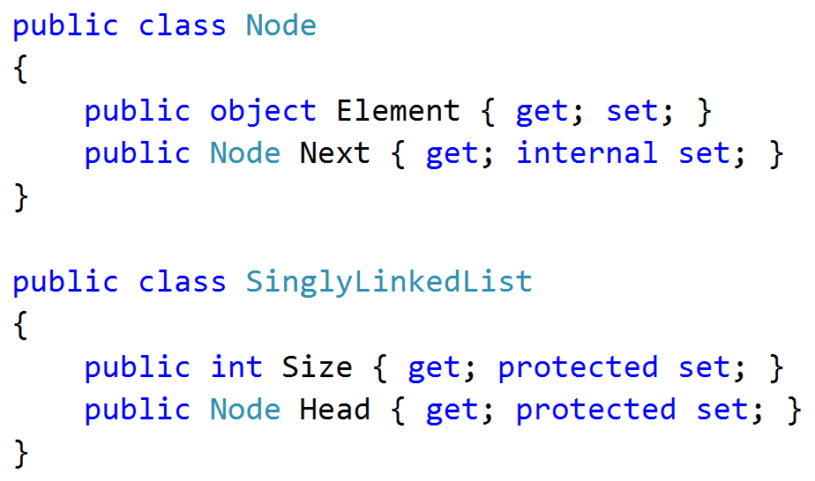
Singly Linked Lists

Slide 11
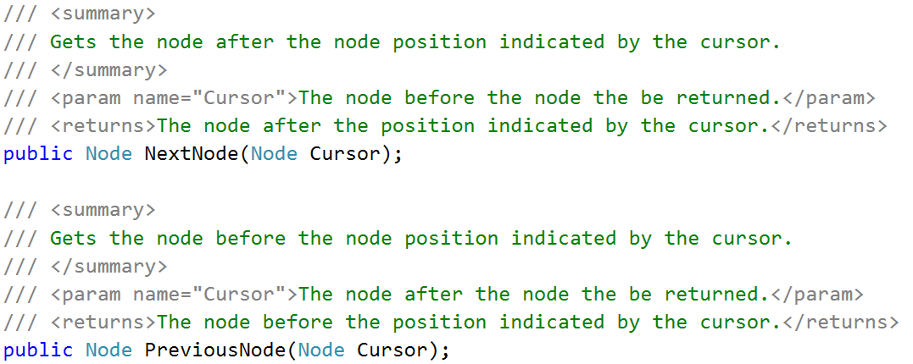
Operations on Singly Linked Lists

Slide 12
Operations on Singly Linked Lists
Implementing the NextNode Operation for any given node, is easy as in Singly Linked Lists, each node holds a pointer to the next Node in the chain.
Implementing the PreviousNode operation is trickier; there is no reference to the previous node from a given node!
How can the previous node be obtained?

Slide 13
Operations on Singly Linked Lists
Head : Node
Cursor : Node
∅
A
B
C

Slide 14

Operations on Singly Linked Lists
Head : Node
currentNode : Node
Cursor : Node
∅
A
B
C

Slide 15
Operations on Singly Linked Lists
Head : Node
currentNode : Node
Cursor : Node
∅
A
B
C
true

Slide 16
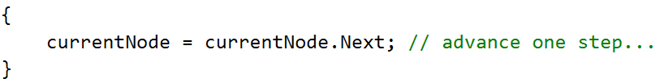
Operations on Singly Linked Lists
Head : Node
currentNode : Node
Cursor : Node
∅
A
B
C

Slide 17
Operations on Singly Linked Lists
Head : Node
currentNode : Node
Cursor : Node
∅
A
B
C

Slide 18
Operations on Singly Linked Lists
Head : Node
currentNode : Node
Cursor : Node
∅
A
B
C
false

Slide 19
Operations on Singly Linked Lists
Head : Node
currentNode : Node
Cursor : Node
∅
A
B
C

Slide 20
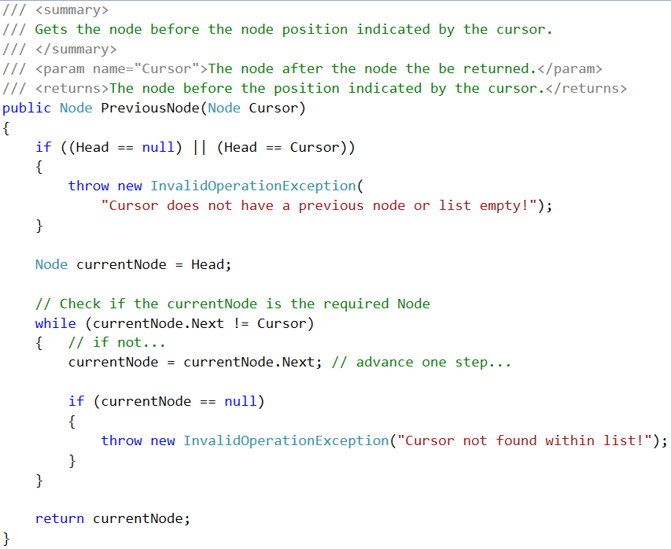
Operations on Singly Linked Lists

Slide 21
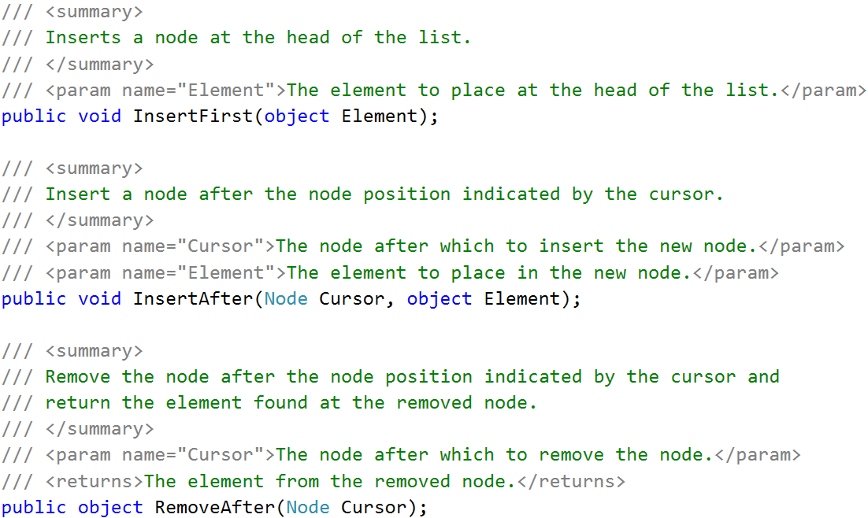
Operations on Singly Linked Lists

Slide 22
Operations on Singly Linked Lists
The InsertFirst operation creates a new node and places it at the head of the list:

Slide 23

Operations on Singly Linked Lists
Head : Node
Element
∅
∅
A
B
C

Slide 24

Operations on Singly Linked Lists
Head : Node
Element
∅
∅
A
B
C

Slide 25

Operations on Singly Linked Lists
Head : Node
Element
∅
A
B
C

Slide 26
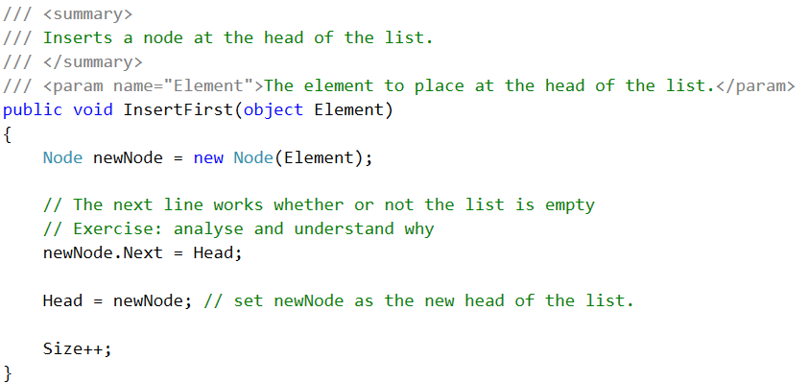
Operations on Singly Linked Lists

Slide 27
Operations on Singly Linked Lists
Exercise:
Implement the InsertAfter operation.
What is the time complexity of this operation?

Slide 28
Operations on Singly Linked Lists
Exercise:
Implement the RemoveAfter operation.
What is the time complexity of this operation?

Slide 29
Operations on Singly Linked Lists
The RemoveFirst operation will remove the Head of the list and return the element found at the head.
When implementing this operation, it is important to check if:
The list is empty and therefore Head is null
After removing the head of the list, the Head is updated to the Node after the original head of the list.
Exercise:
How would you implement the above method?

Slide 30
Operations on Singly Linked Lists
The RemoveAtCursor is another operation that can be added to a Singly Linked List.
The RemoveAtCursor can be implemented in a simple manner by dividing the operation into separate cases:
The Cursor cannot be found within the list at all (in this case, the operation is invalid!);
The Cursor is the head of the list, and therefore, the operation is reduced to the RemoveFirst operation.
There is a Node pervious to the cursor Cursor. This method is reduced to the RemoveAfter operation once the previous cursor is found.

Slide 31
Operations on Singly Linked Lists
Searching for the Cursor Node through a linked lists is inefficient
Getting an element at a rank is also inefficient
These operations take O(n) time, meaning that, if n represents the maximum number of nodes in a list, the operation would involve having through go through all the nodes in the list.
However, Singly Linked Lists allow for very fast insertion and removal of nodes at a given position.

Slide 32
Operations on Singly Linked Lists
Exercise:
When does the best case of the previous operation happen?
What is the maximum number of nodes the operation would have to go through in the best case?
What is the maximum number of nodes the operation would have to go through in the worst case?

Slide 33
Queues and Stacks using Singly Linked List
A Singly Linked List can be designed in order to create an efficient Queue or an efficient Stack.
This makes the operations for these 2 data structures much more efficient thank when implemented with an ArrayBased Vector.
An efficient queue built using a Singly Linked List always takes the same amount of time (constant time) to Enqueue and Dequeue elements.
The same can be said for the Stack Push and Pop operations using a Singly Linked List.
Exercise:
Use a cursor placed at a strategic position and the operations of the Singly Linked List discussed before to implement an efficient Queue.

Slide 34
Queues and Stacks using Singly Linked List
Exercise:
Use Singly Linked Lists to implement
1. An Efficient Queue
2. An Efficient Stack

Slide 35
End of lesson
Any questions?

